Slide 1
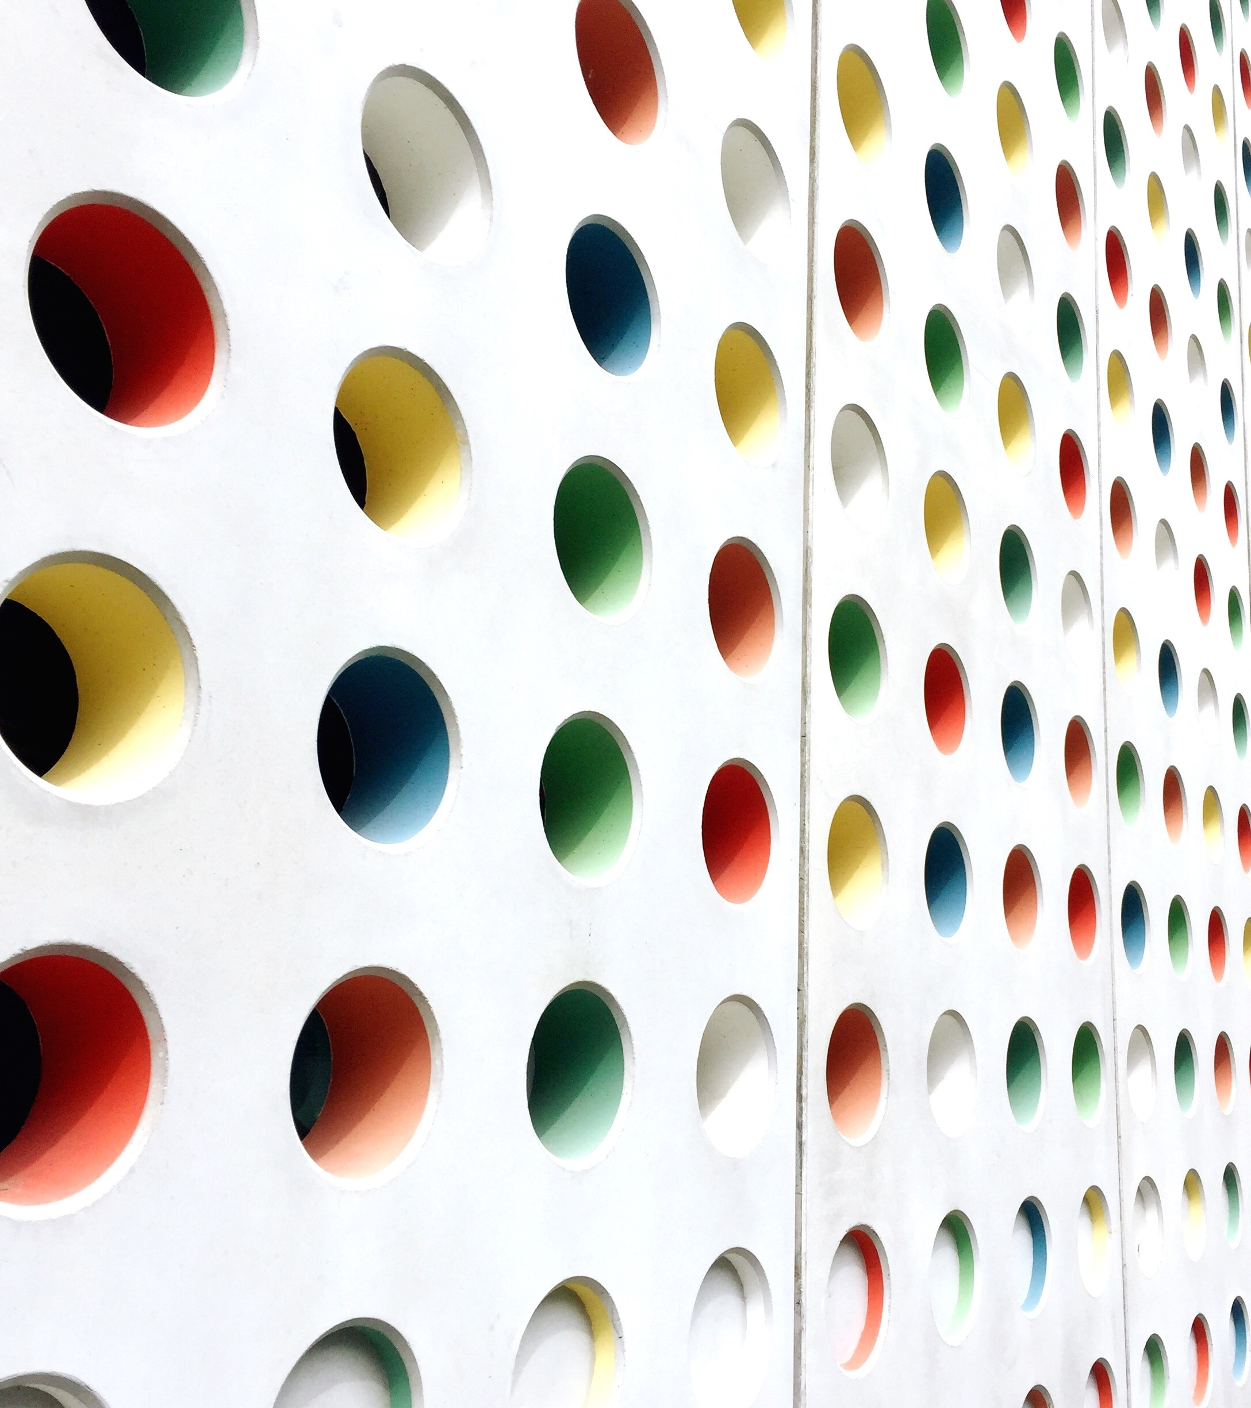
The Weather App
Anthony Malunga
St10452399

Slide 2
The Weather App.
The purpose of the app.
Screenshots of the screens with descriptions.
Screenshots of erros.

Slide 3
Purpose of the app.
The purpose of this app is to provide users with not only the average temperature for the week but also allows the user to get information on how low(the minimum) and how high(the maximum) temperature of that day will be. The app will also include the type of condition it will be for example; will it be sunny or cloudy.

Slide 4
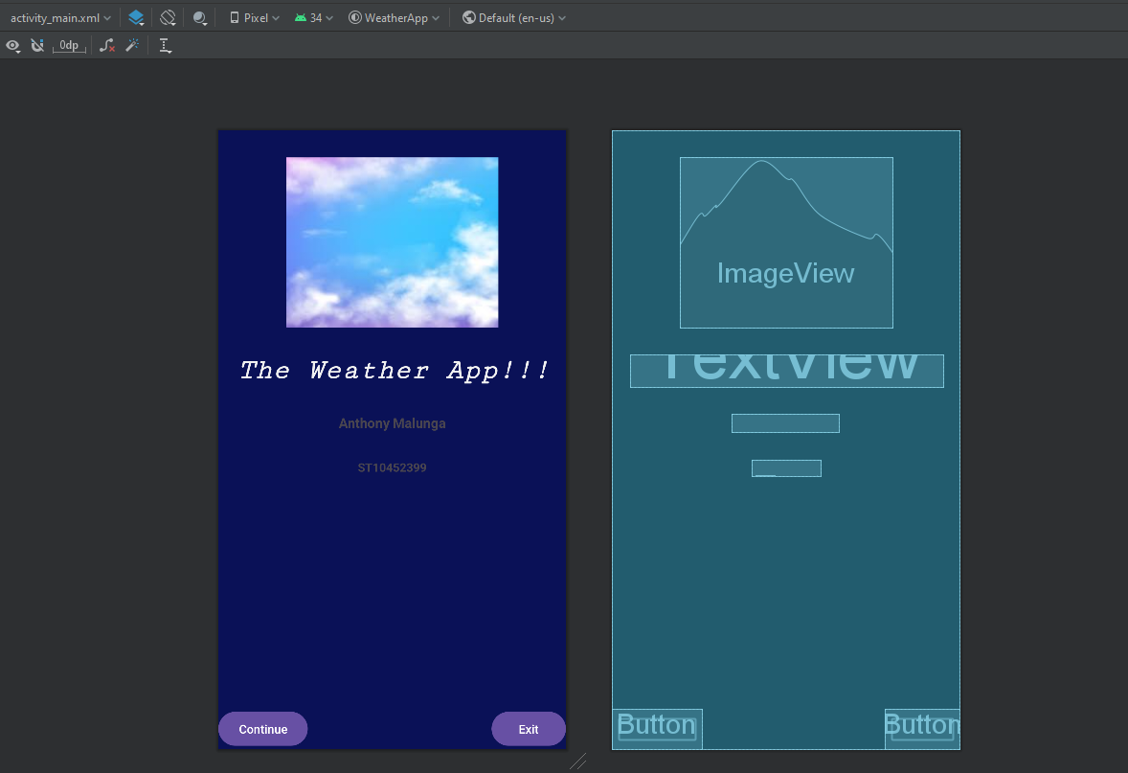
Splash Screen
This is the first page that will pop up when the app is open, on this page you will see the name of the app, my name and student number.
On this screen you will see 2 buttons the one will allow you to continue using the and the other will take you out of the app(exit)

Slide 5
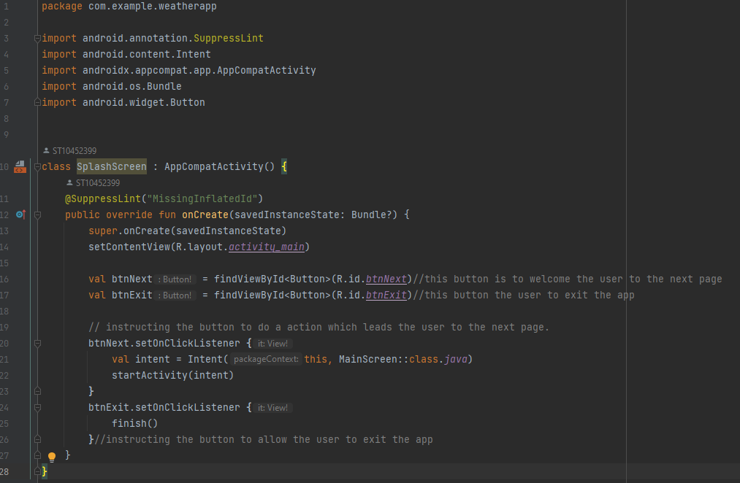
Slash screen code.
This is the code for the splash we instruct/tell the program what to do when a button is pressed. As you can see in lines 16 and 17, we declare the buttons only because on this screen we are on dealing with the buttons. Lines 20 to 22 we give the button an instruction for when clicked it should go to the next page. Lines 24 and 25 is where we instruct the exit button to close the app when clicked.

Slide 6
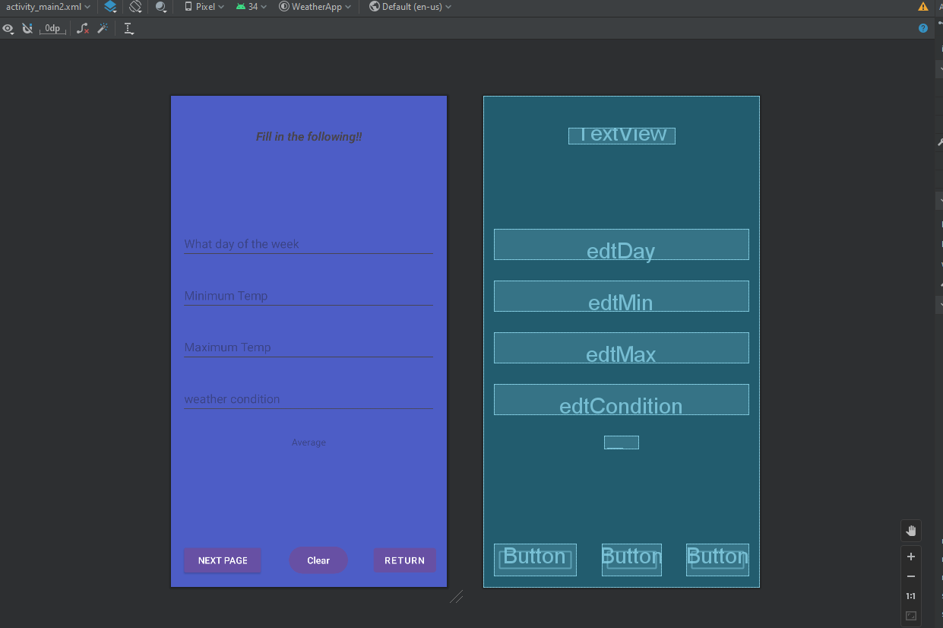
The Main screen
This the screen that you see after pressing the continue button on the slash screen. As you can see on this screen we prompt the user to give us the information that they are asking for.
Here we use 3 relevant buttons(Next page, Clear, Return) all three have specific tasks.
We also prompt the user to input different data types(strings and integers)
The only display on this page is the Average, after clicking “Next Page” the app will calculate the average and display it for you on the same page before clicking the button again to continue to the Detail page.

Slide 7
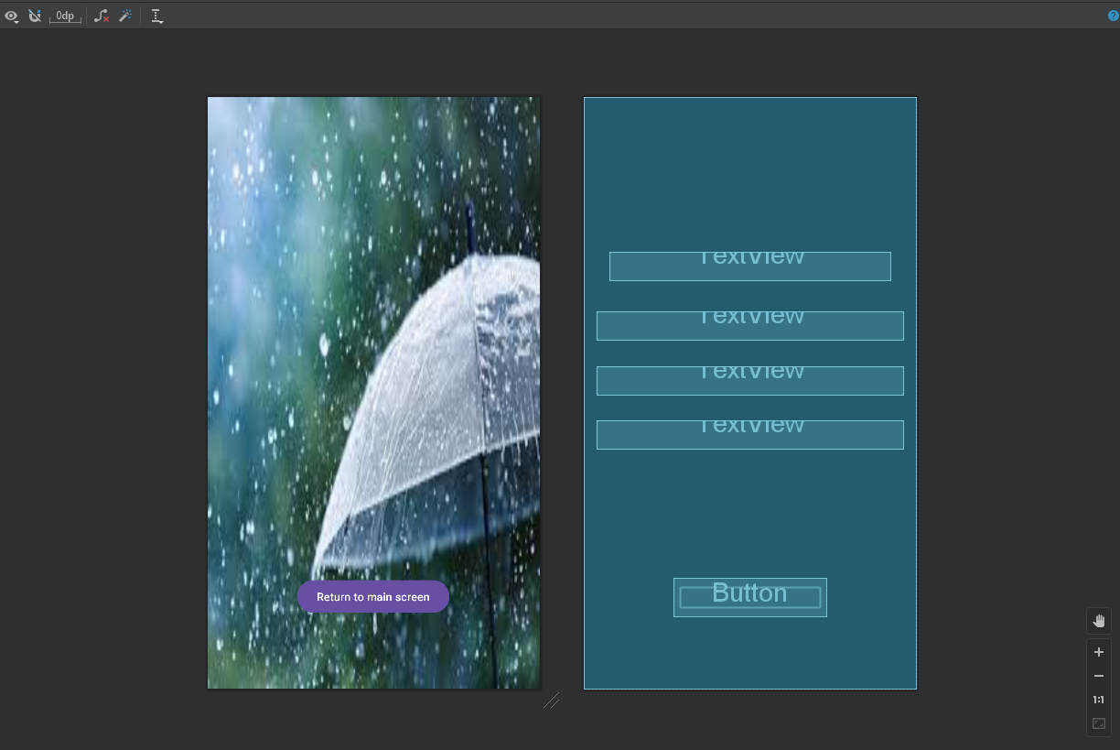
Detailed view Page
This screen displays the detailed information that the user entered on the previous page(main screen), this page will include the max , min and weather conditions.
There is also a button that is instructed to return the suer back to the main screen.

Slide 8
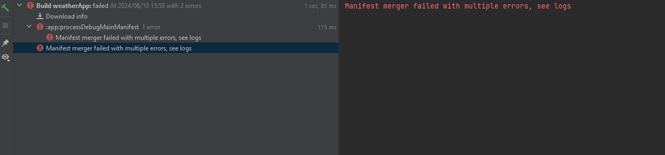
Errors
The errors that I frequently got were syntax errors, only got to fix them when I was done coding after hat the app was running well everything was working perfectly. When I went to run the app again the app stopped responding yet there are no errors whatsoever.

Slide 9
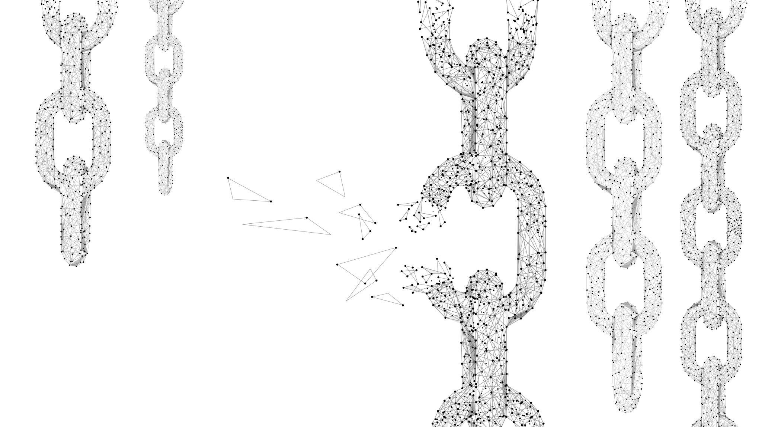
Links.
https://advtechonline-my.sharepoint.com/personal/st10452399_vcconnect_edu_za/Documents/readMe%20for%20practicum.docx?web=1
https://github.com/ST10452399/haw1-imad5112-practicum-submission-ST10452399.git

